Slide 1
ENERGY STORAGE SYSTEMS FOR EV | 7EL304 | MINI PROJECT
SOC-Based Passive
Cell Balancing for a
Series Li-ion Pack
Simulink / Simscape Battery model with Monte Carlo analysis of cell mismatch
80%
75%
75%
Team: [member names]
Guide: [faculty name]
Department of Electrical Engineering | October 2026
Three cells in series with unequal SOC: the imbalance the balancer removes

Slide 2
Contents
1
Problem statement and objectives
3
2
Methodology and system specification
4
3
Modelling: cell, pack architecture, control
5-7
4
Results: identical and mismatched cells
8-9
5
Monte Carlo analysis
10-12
6
Conclusion, future work and references
13

Slide 3
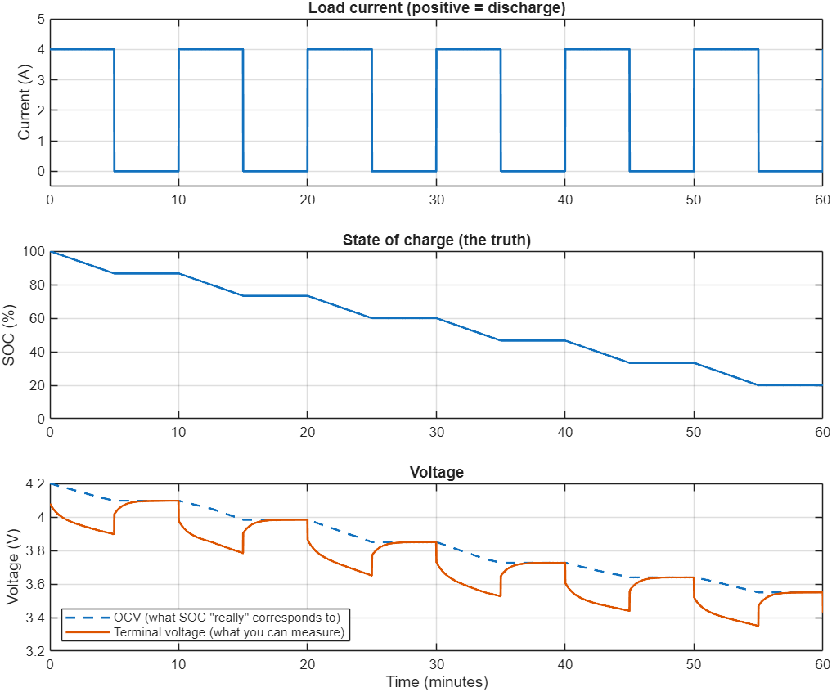
Problem Statement and Objectives
Problem
Cells in series carry the same current; capacity and R0 spread makes their SOC drift apart
Usable pack capacity = weakest cell, so imbalance wastes capacity and ages that cell
Voltage-based balancing is unreliable: at equal SOC the cell reads 3.897 V under load and 4.097 V at rest (0.20 V error) [2], [4]
Objectives
Model a 3S Li-ion pack with per-cell passive balancing in Simulink/Simscape Battery
Drive the bleed decision by SOC with hysteresis, under a charge/rest/discharge cycle
Quantify balancing time, dissipated energy and final spread, including a Monte Carlo study over random cell mismatch
Fig. 1. Single cell, 4 A pulses: voltage sags while SOC is unchanged.

Slide 4
Methodology and System Specification
1 Cell model
2 Validation
3 Pack model
4 Control
5 Case studies
6 Monte Carlo
1-RC equivalent circuit
vs. independent script
3 cells + bleed circuits
SOC rule + mode supervisor
identical and mismatched cells
200 random packs, parallel runs
TABLE I
PACK AND SIMULATION PARAMETERS
Pack Ah equals cell Ah (series); voltage adds
Same model for every study; only Cap, R0 scale and initial SOC change
All numbers live in one parameter script
Parameter | Value
Configuration / cell | 3S1P, Li-ion 3.7 V, 2.5 Ah per cell
Pack capacity / voltage / energy | 2.5 Ah / 11.1 V (9.0-12.6 V) / 27.75 Wh
Charge / discharge current | 1.25 A (0.5C)
Charge cut-off / resume; discharge limit | 4.20 V / 4.15 V (highest cell); 3.00 V (lowest)
Bleed resistor | 47 Ω per cell (≈ 88 mA, ≈ 3.5 % of 1C) [3]
Balancing ON / OFF | ΔSOC > 1.0 % / < 0.5 %
Cycle and BMS sample time | 90 / 20 / 40 / 10 min; 1 s

Slide 5
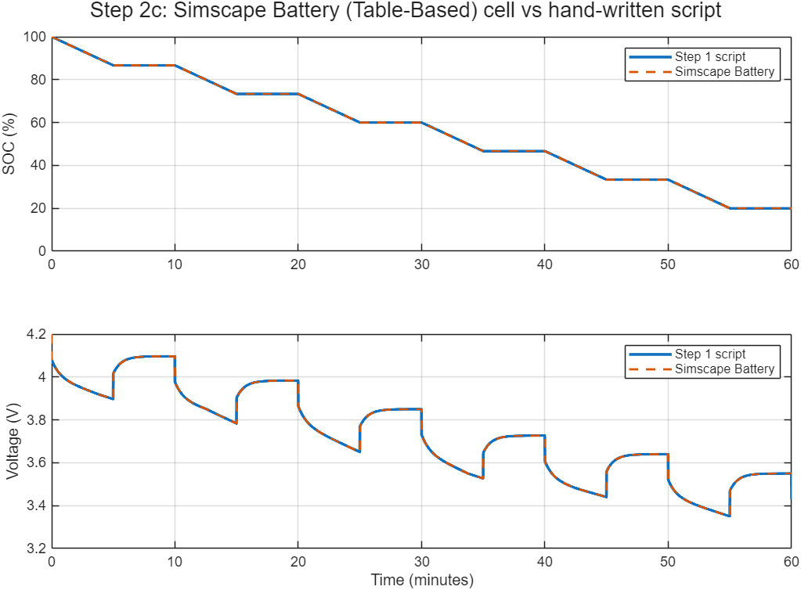
Cell Model and Validation
OCV(SOC)
R₁
R₀
+ V_t
C₁
SOC = SOC₀ − (1/Q) ∫ I dt
dV₁/dt = −V₁/(R₁C₁) + I/C₁
V_t = OCV(SOC) − I·R₀ − V₁
I > 0 = discharge. Q = 2.5 Ah, R₀ = 30 mΩ, R₁ = 20 mΩ, τ = R₁C₁ = 40 s. OCV from a lookup table over SOC.
TABLE II
MEAN VOLTAGE ERROR VS. REFERENCE SCRIPT
Implementation | Error
Simulink, no RC | 0.040 V
Simulink, with RC | 0.0001 V
Simscape Battery (used) | 0.0006 V
Fig. 2. Simscape Battery block vs. the hand-written script: curves overlap.

Slide 6
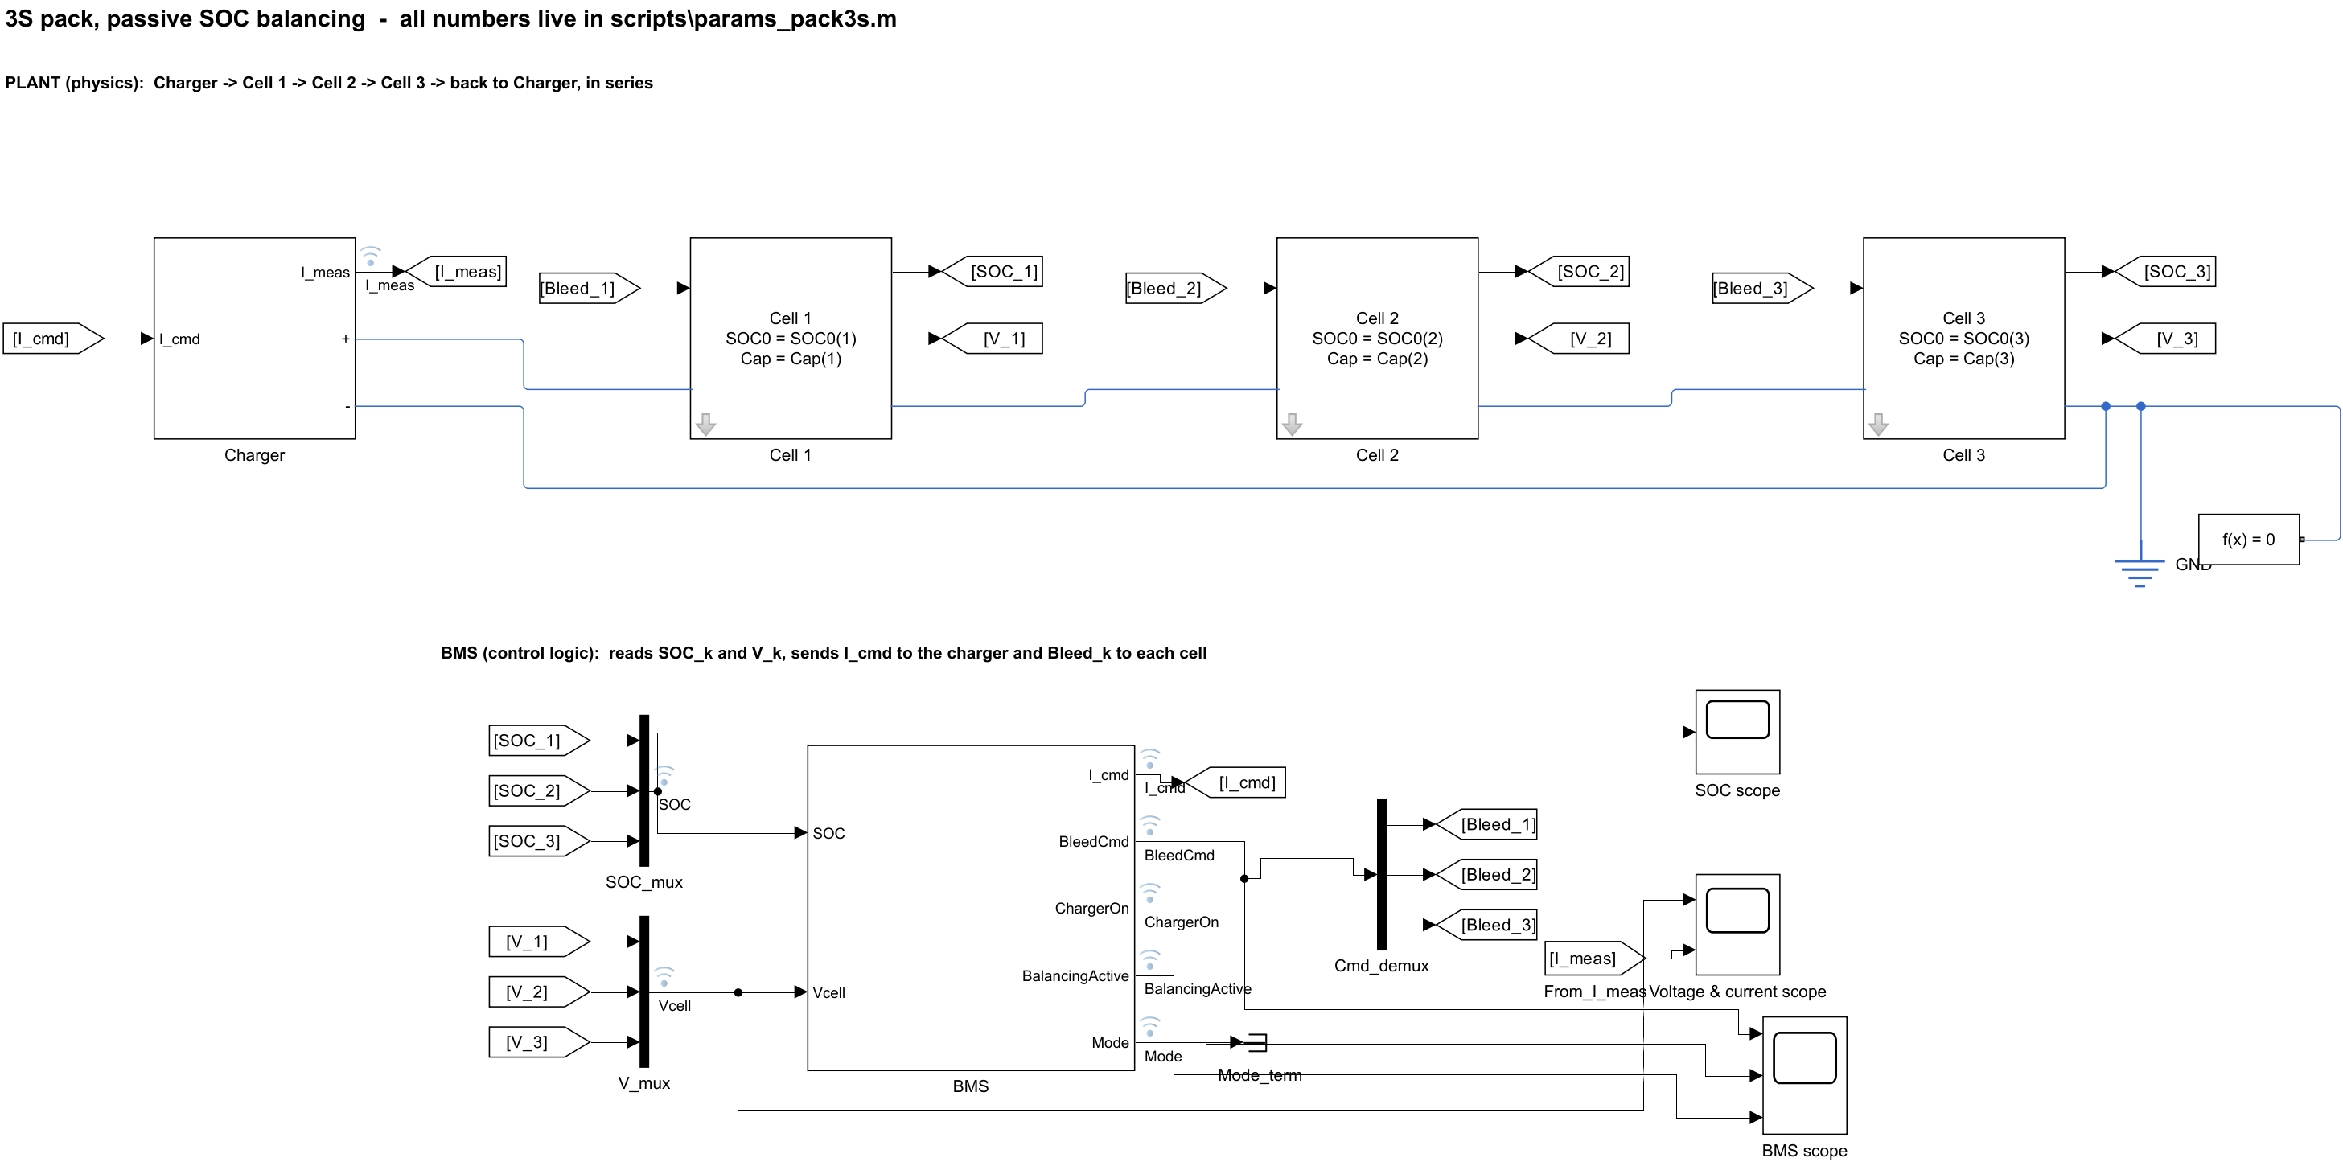
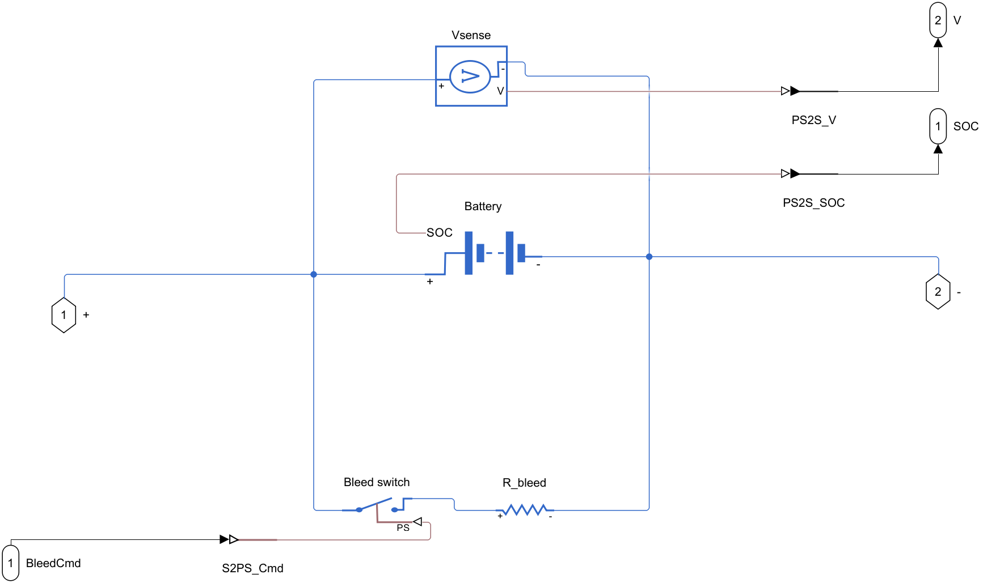
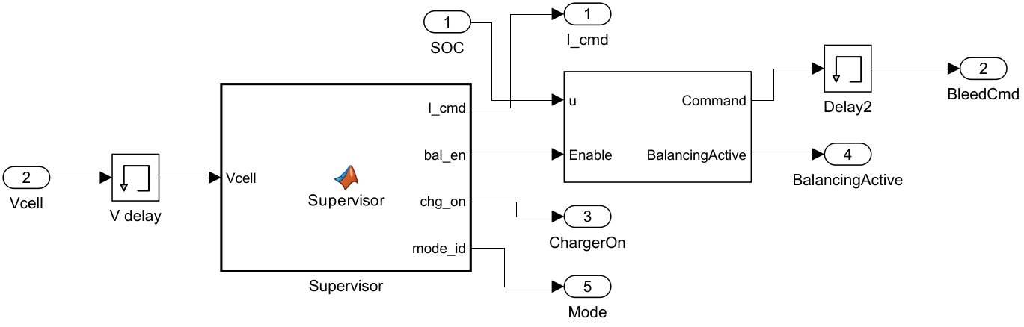
Pack Model Architecture
Built iteratively: single cell, 3S string, 4.2 V cut-off, bleed circuits; the flat 41-block model was then restructured
Subsystems for easier viewing: masked Cell k (battery, bleed switch, 47 Ω, sensors), Charger, BMS
Plant separated from control, as hardware and firmware in a real pack
Goto/From tags replace crossing wires; one parameter script, no values typed into blocks
Fig. 3. Final model: plant (Charger, Cells 1-3) above, BMS below.
Fig. 4. Inside Cell k (masked subsystem).
Fig. 5. Inside BMS: supervisor and balancing logic.

Slide 7
SOC-Based Control Law and BMS Supervisor
CHARGE
REST
DISCHARGE
REST
+1.25 A, 90 min
0 A, 20 min
−1.25 A, 40 min
0 A, 10 min
Balancing ON
Balancing ON
Balancing OFF
Balancing ON
Supervisor cycle repeats; charge stops at V_max ≥ 4.20 V and resumes below 4.15 V; discharge also ends at V_min ≤ 3.0 V.
ΔSOCₖ = SOCₖ − minⱼ(SOCⱼ)
Lowest-SOC cell is the reference; only higher cells are bled
Hysteresis prevents switch chatter
Decision uses SOC, so load current does not corrupt it
Balancing blocked in DISCHARGE: it would waste energy twice
MATLAB Function supervisor, 1 s; Simscape Passive Cell Balancing block [5]
Sₖ → ON if ΔSOCₖ > 1.0 %
Sₖ → OFF if ΔSOCₖ < 0.5 %
unchanged in between (hysteresis)
only while the supervisor allows balancing

Slide 8
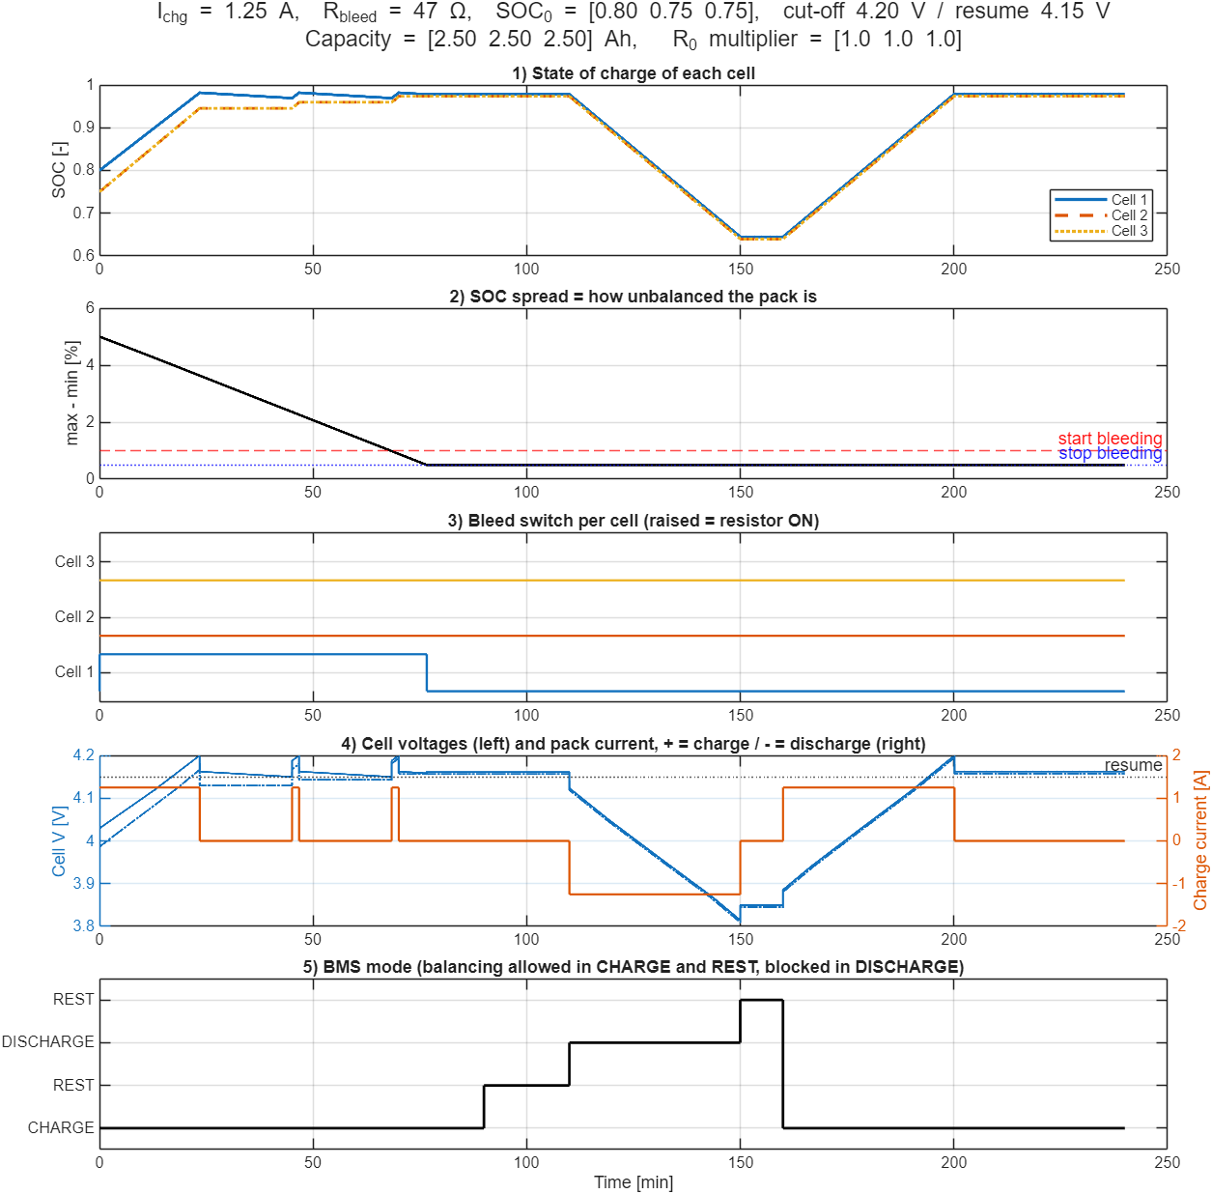
Results A: Identical Cells
SOC₀ = 0.80 / 0.75 / 0.75; Q = 2.5 / 2.5 / 2.5 Ah; R₀ scale = 1 / 1 / 1
SOC spread falls from 5.0 % to below 1 % in 68.1 min, during the first charge
Only Cell 1 (highest SOC) is bled: 76.6 min
Dissipated energy 1680 J (0.47 Wh), 1.7 % of pack energy
Spread settles at 0.5 %, the hysteresis OFF threshold
Identical cells drift together, so no new imbalance after discharge
Fig. 6. SOC, spread, bleed commands, voltage/current, mode.

Slide 9
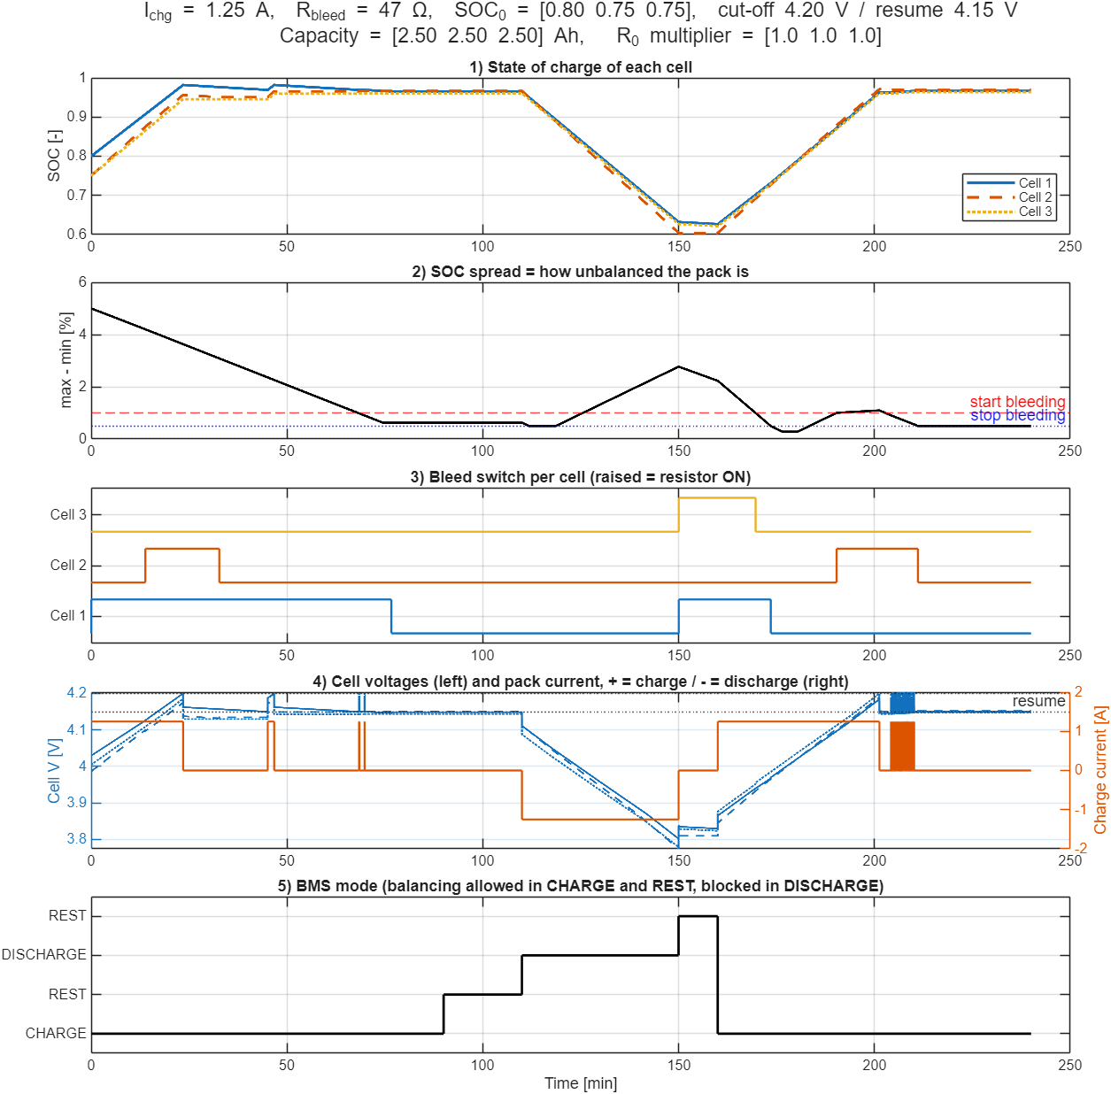
Results B: Capacity and Resistance Mismatch
TABLE III
CASE A VS. CASE B, ONE 240 MIN CYCLE
Metric | A: identical | B: mismatch
Time to spread < 1 % | 68.1 min | 68.1 min
Peak spread after discharge | ≈ 0.5 % | 2.8 %
Bleed time C1 / C2 / C3 (min) | 76.6 / 0 / 0 | 100 / 39.6 / 19.6
Energy dissipated | 1680 J | 3374 J
Share of pack energy | 1.7 % | 3.4 %
Final spread | 0.5 % | 0.5 %
The 2.3 Ah cell empties faster in discharge; spread rebounds to 2.8 %
Balancing in rest and charge restores 0.5 %
Mismatch does not slow first convergence but doubles the heat lost
Imbalance is regenerated every cycle: balancing is continuous work
Fig. 7. Q = 2.5 / 2.3 / 2.5 Ah; R₀ scale = 1 / 1 / 1.5.

Slide 10
Monte Carlo Study: Sampling Logic
Why: two hand-picked cases show one pack. Real packs have random cell-to-cell spread, so we ask how the result is distributed over many packs.
TABLE IV
RANDOM INPUTS OF EACH PACK (3 CELLS, DRAWN INDEPENDENTLY)
Procedure
Input | Distribution | Rationale
Capacity Q_k | Normal, mean 2.5 Ah, σ = 2 % | Literature: mostly within ±5 % (≈ 2.5σ)
R₀ multiplier | Normal, mean 1, σ = 10 %, floor 0.5 | Reported spread ±3 % to ±30 %
Initial SOC_k | [0.80 0.75 0.75] + N(0, 2 pts), clipped 0.30-0.95 | Keeps the imbalance case, varies it
Fixed seed rng(42): same 200 packs every run
One SimulationInput per pack via setVariable (Cap, R0_scale, SOC0)
parsim on 4 workers (Parallel Computing Toolbox): ≈ 6 min for 200 runs
Same model and control law as Cases A and B; nothing in the model was changed
Normal rather than uniform: cells cluster near nominal, extremes are rare
Metrics: time to spread < 1 %, peak and final spread, bleed time, bleed energy, usable capacity (min Q)
Metrics extracted from logged signals of each run
Statistics: mean, σ, 95th percentile, worst case

Slide 11
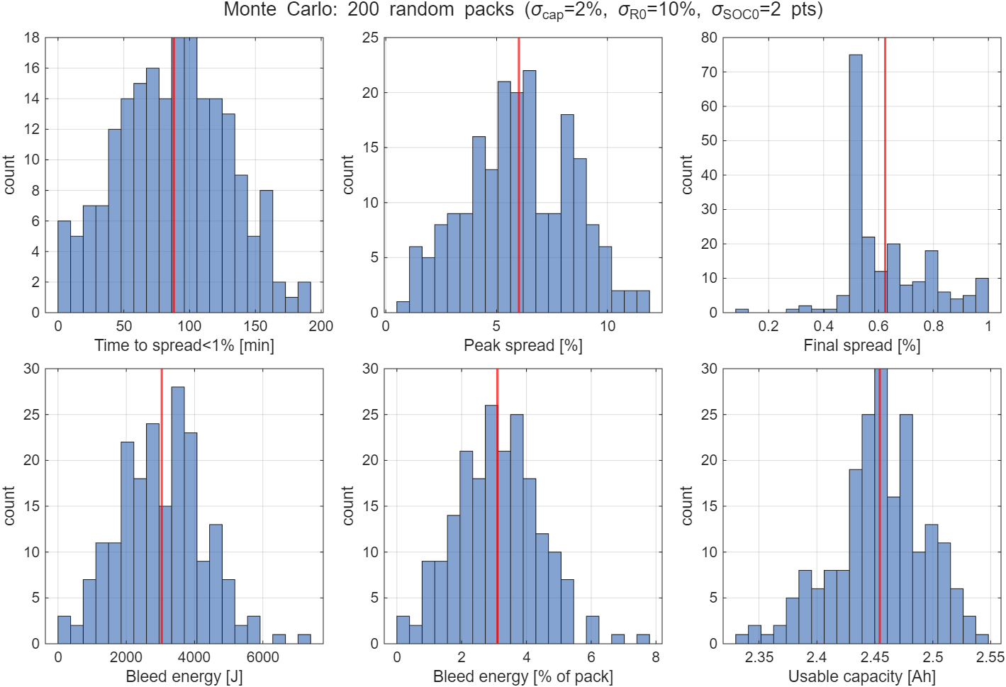
Monte Carlo Results: Distributions over 200 Packs
TABLE V
SUMMARY STATISTICS, N = 200
Metric | Mean ± σ | P95
Time to < 1 % (min) | 88 ± 42 | 159
Peak spread (%) | 6.0 ± 2.4 | 9.9
Final spread (%) | 0.62 ± 0.16 | 0.95
Bleed energy (J) | 3040 ± 1260 | 4990
Bleed / pack energy (%) | 3.1 ± 1.3 | 5.1
Usable capacity (Ah) | 2.45 ± 0.04 | 2.52
All 200 packs end below 1 % spread (max 1.0 %)
Bleed cost varies widely: up to 7.6 % of pack energy (worst pack)
Weakest cell cuts usable capacity to 2.34-2.55 Ah
Fig. 8. Histograms (red line = mean).

Slide 12
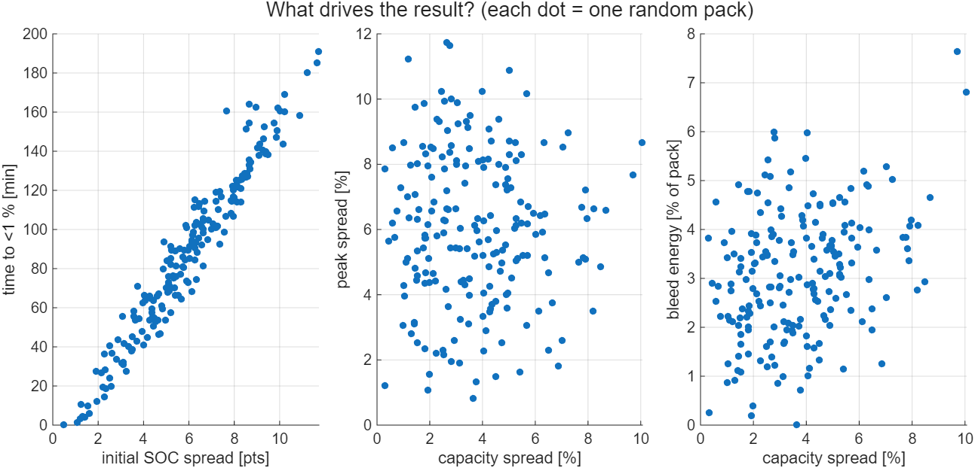
Monte Carlo: What Drives the Result?
Fig. 9. Each dot is one random pack.
Time to balance rises almost linearly with the initial SOC spread (≈ 16 min per SOC point): the bleed current of 88 mA sets the speed
Peak spread is set mainly by the starting imbalance; capacity spread has little effect on it
Bleed energy shows a weak upward trend with capacity spread; at σ = 2 % the initial SOC offset still dominates, so a larger σ_cap would be the next sensitivity test

Slide 13
Conclusion, Future Work and References
3S pack (11.1 V, 2.5 Ah, 27.75 Wh) with per-cell passive balancing modelled and validated (cell error ≤ 0.6 mV)
SOC-based rule with hysteresis and a mode supervisor cut the spread from 5 % to 0.5 %
Mismatch doubles dissipated energy (0.47 → 0.94 Wh per cycle)
Monte Carlo (200 packs): all packs balanced; heat cost 3.1 ± 1.3 % of pack energy, up to 7.6 %
TABLE VI
LIMITATIONS AND FUTURE WORK
Limitation | Next step
True SOC used by BMS | Coulomb counting, then EKF
No voltage-trigger baseline | Switchable voltage rule
Electrical model only | Thermal model
Heat dissipated | Active balancing
AI use disclosure. Claude (Anthropic) [6] assisted with MATLAB/Simulink scripting, the Monte Carlo script, literature lookup and drafting of this presentation. The authors ran and checked the simulations and take responsibility for all content.
[1] Texas Instruments, "Cell balancing with BQ769x2 battery monitors," App. Note SLUAA81.
[2] "Cell balancing paradigms: advanced types, algorithms, and optimization frameworks," arXiv:2411.05478, 2024.
[3] "A deeper look into active balancing on BMS, Part 1," Embedded Computing Design.
[4] "SOC estimation for onboard LiFePO4 batteries with adaptive state update in specific OCV ranges," Applied Energy, 2023.
[5] The MathWorks, Inc., "Simscape Battery: Battery (Table-Based) and Passive Cell Balancing," MATLAB R2025b doc., 2025.
[6] Anthropic, "Claude" [Large language model], 2026. [Online]. Available: https://claude.ai

